Slide 1
CMSC 304
Introduction to C & The Environment
Claire Sparks

Slide 2
C
C is a high level, compiled, imperative programming language
  First released in 1972 (!)
C is an imperative language like Java and it's underlying behaviors are similar
  C was a major inspiration for Java and other later imperative languages
But C was developed in an era where computational power was much more scarce
  While still a high level language, there's less abstraction than more modern languages
  Requiring us as programmers to engage with concepts other languages abstract away

Slide 3
C Data Types
C has two categories of data types:
  Basic types
    void
    Numeric types:
      Integers (12 possible kinds)
        Integer types can be signed or unsigned
      Real numbers (3 possible kinds)
    No Boolean type!
      In C, 0 represents false and all other numeric values represent true
  Derived types
    Combine existing types into a new data type
      i.e. they are derived from other data types
      Also referred to as compound data types
Notes:
Modern versions of C have tweaked how Booleans work but let’s stick with the OG understanding and build up from first principles
THIS IS A GREAT REASON WHY YOU DON’T TRUST CHAT MINDLESSLY!!
”Does C support Booleans?” → ”yes it does, here’s some working code examples” but not telling you it’s all C23 code examples and that’s NOT what we’re talking about!!

Slide 4
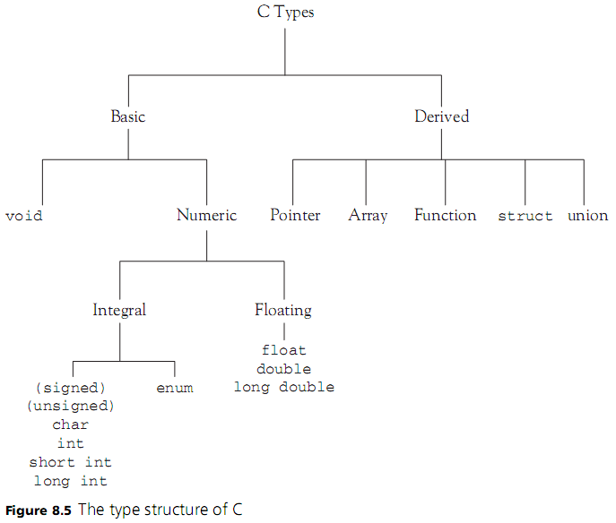
C Data Types
Notes:
char is an integral number!
Function is a derived type because it takes in types as input and returns types as output
Ok so you can have a function that doesn’t take in any data or return anything but leave me alone idk classification is hard! 😭

Slide 5
Basic Program in C
Must have a defined entry point
  int main(void)
    The return value is a signal to the OS, not something we're worried about
C is a statically typed language
  All variable declarations must specify the type of data they store
  Typing system is not very robust and can be subverted with little effort
    In C, the type rules are more like guidelines
    Very, very unsafe!
C programs are made up of header (.h) and source (.c) files
  Each source file has an associated header file
Why have two files when other languages we've seen have one?
  lot's of reasons, we’ll cover ones relevant to us

Slide 6
C Header Files
Constants
  Defined in the header file using the #define keyword
Enums
Structs
  Like an object with all public variables, no methods, no static variables
  Structs have state but no behavior
Include statements
  Similar to import statements in Java / Python
  Can specify other header files to be included in compilation
  Allows us access to any information (constants, enums, structs, functions) defined in those headers

Slide 7
C Header Files
Declaring function prototypes
  Function prototype: A function declaration which doesn't have a function body
    int foo(int x);
  Similar to an anonymous function in Java
Python and Java don't do this, why does C?
When compiling a file, the C compiler reads the file from top to bottom a single time
If the C compiler sees a function call before it sees the function definition, the compilation fails!
  The compiler doesn't know what the function call means and throws a function undefined error
Notes:
A function prototype is a forward deceleration.

Slide 8
C Header Files
Modern languages solve this issue by having the compiler read a file multiple times
But the compiler reading a file multiple times dramatically increases the amount of computation required
And C is from an era of scarce computational resources!
So the C compiler does a single pass to improve computational efficiency
Left up to the programmer to deal with any annoyances the single pass paradigm causes

Slide 9
C Header Files
To get the C Compiler to always recognize your function calls:
  A) Arrange your program so functions are always defined before they're used
    B A D
  B) Place function prototypes in the header
    Y E S
The C compiler
  reads the header first
  translates the function prototypes
  then the compiler can recognize function calls in the source file
    even if the call happens before the function declaration!

Slide 10
C Header Guards
Lastly, all header files need header guards
Prevents re-declaration for multiple dependencies
            #ifndef HEADER_NAME_H
            #define HEADER_NAME_H
            //header code here…
            #endif

Slide 11
Compiling a C Program
gcc -std=c99 -o HelloWorld.out HelloWorld.c
gcc compiler
-std → using c99
-o → compiling to a file
Name of your output file / executable
List of c files to compile, no header files
All c files must include a correspondingly named h file
c99 is the version of C we will use for this class
  language features introduced in later versions of C can’t be used
Notes:
gcc -std=c99 -o HelloWorld.out HelloWorld.c

Slide 12
OpenWorld C Code Demo

Slide 13
Memory
Computer memory consists of a linear array of addressable storage
  Typically, each addressable piece of memory can store up to a single byte of data
Computer memory is made addressable by associating a unique value (known as a memory address) to each storage location
A memory address is word sized
  A word is a fixed-sized piece of data handled as a unit by the processor
Word size determines how much overall data a computer can address
  A computer with a 32 bit word can only store 2³² bytes in memory, any more and we won’t be able to give each value a unique memory address!
Notes:
So like, yes, if each piece of memory stores a byte and a word is 4 bytes, then each word requires 4 storage locations to be stored

Slide 14
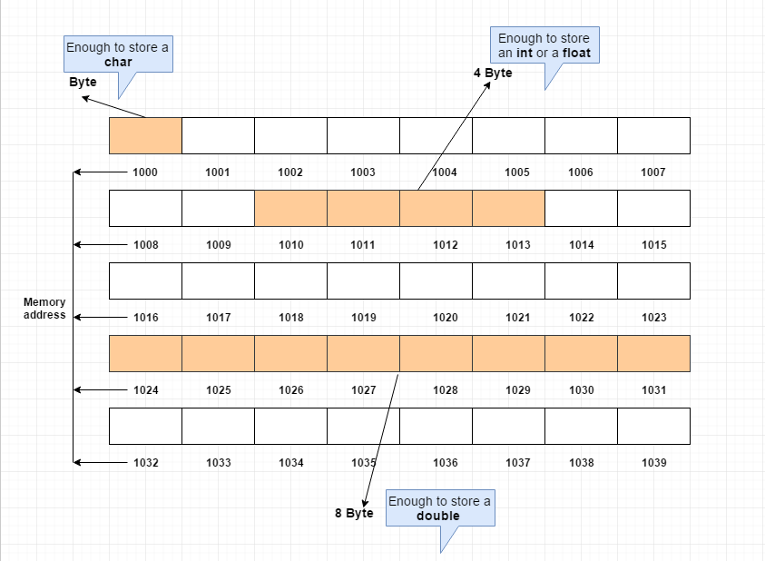
Memory

Slide 15


Lifetimes and the Environment
Binding: process of associating an attribute with a name
Environment: maintains the bindings of names to storage locations
Memory: bindings of storage location to values
Both the environment and memory maintain dynamic bindings
  Thus both are created and maintained at runtime

Slide 16
Lifetimes and the Environment
The period of time between the creation and the destruction of a name-to-location binding is called the binding’s lifetime
Similarly, the time between the creation and destruction of an object is the object’s lifetime
Object lifetimes generally correspond to one of three principal storage allocation mechanisms, used to manage the object’s space:
  Static objects are given an absolute address that is retained throughout the program’s execution
  Stack objects are allocated and deallocated in last-in, first-out order in conjunction with function calls and returns
  Heap objects may be allocated and deallocated at arbitrary times
Notes:
Objects don’t mean OO objects here
how do we bind identifiers to memory locations. This is the only thing we are talking about.
These are 3 separate techniques for maintaining these bindings. 3 separate ways to implement binding identifier to a memory location

Slide 17
Static Objects
Static objects include
  Global variables
  Numeric and string-valued constant literals are also statically allocated
  Most compilers produce a variety of tables that are used by run-time support routines for debugging, dynamic-type checking, garbage collection, exception handling, and other purposes
Statically allocated objects whose value should not change during program execution are often allocated in protected, read-only memory
  Any inadvertent attempt to write to them will cause the operating system to announce a run-time error

Slide 18
Static Objects
If there can never be more than one invocation of a subroutine active at any given time, and a compiler may choose to use static allocation for local variables, effectively arranging for the variables of different invocations to share the same locations, and thereby avoiding any run-time overhead for creation and destruction
If there can never be more than one invocation of a subroutine, then the language can not support recursion
Pre 1990 Fortran is an example of a language which does this

Slide 19
Static Objects
Not all names are bound to locations
In many languages a named constant is required to have a value that can be determined at compile time
  C is one of those languages
Named constants of this sort, together with constant literals, are called compile-time constants

Slide 20
Compile Time Constants
Compile time constants can always be allocated statically
  Multiple instances can share the same location
  Because a constant’s value can’t change, you only ever need one
Names of constants and data types could be just compile-time quantities that do not exist at execution time
  Ex: const int MAX = 10; // MAX is replaced by 10 and the name MAX is never allocated a location

Slide 21
Stack Objects
If a language permits recursion, static allocation of local variables is no longer an option, since the number of instances of a variable that may need to exist at the same time is conceptually unbounded
Fortunately, the natural nesting of function calls makes it easy to allocate space for local variables on a stack.
Each instance of a function at run time has its own stack frame (also called an activation record), containing arguments and return values, local variables, temporaries, and bookkeeping information

Slide 22
Stack Objects
Arguments to be passed to subsequent functions lie at the top of the frame, where the callee can easily find them
The organization of the remaining information is implementation-dependent: it varies from one language, machine, and compiler to another
Moreover, the compiler can arrange for a particular register, known as the frame pointer to always point to a known location within the frame of the current function.
Code that needs to access a local variable within the current frame, or an argument near the top of the calling frame, can do so by adding a predetermined offset to the value in the frame pointer

Slide 23
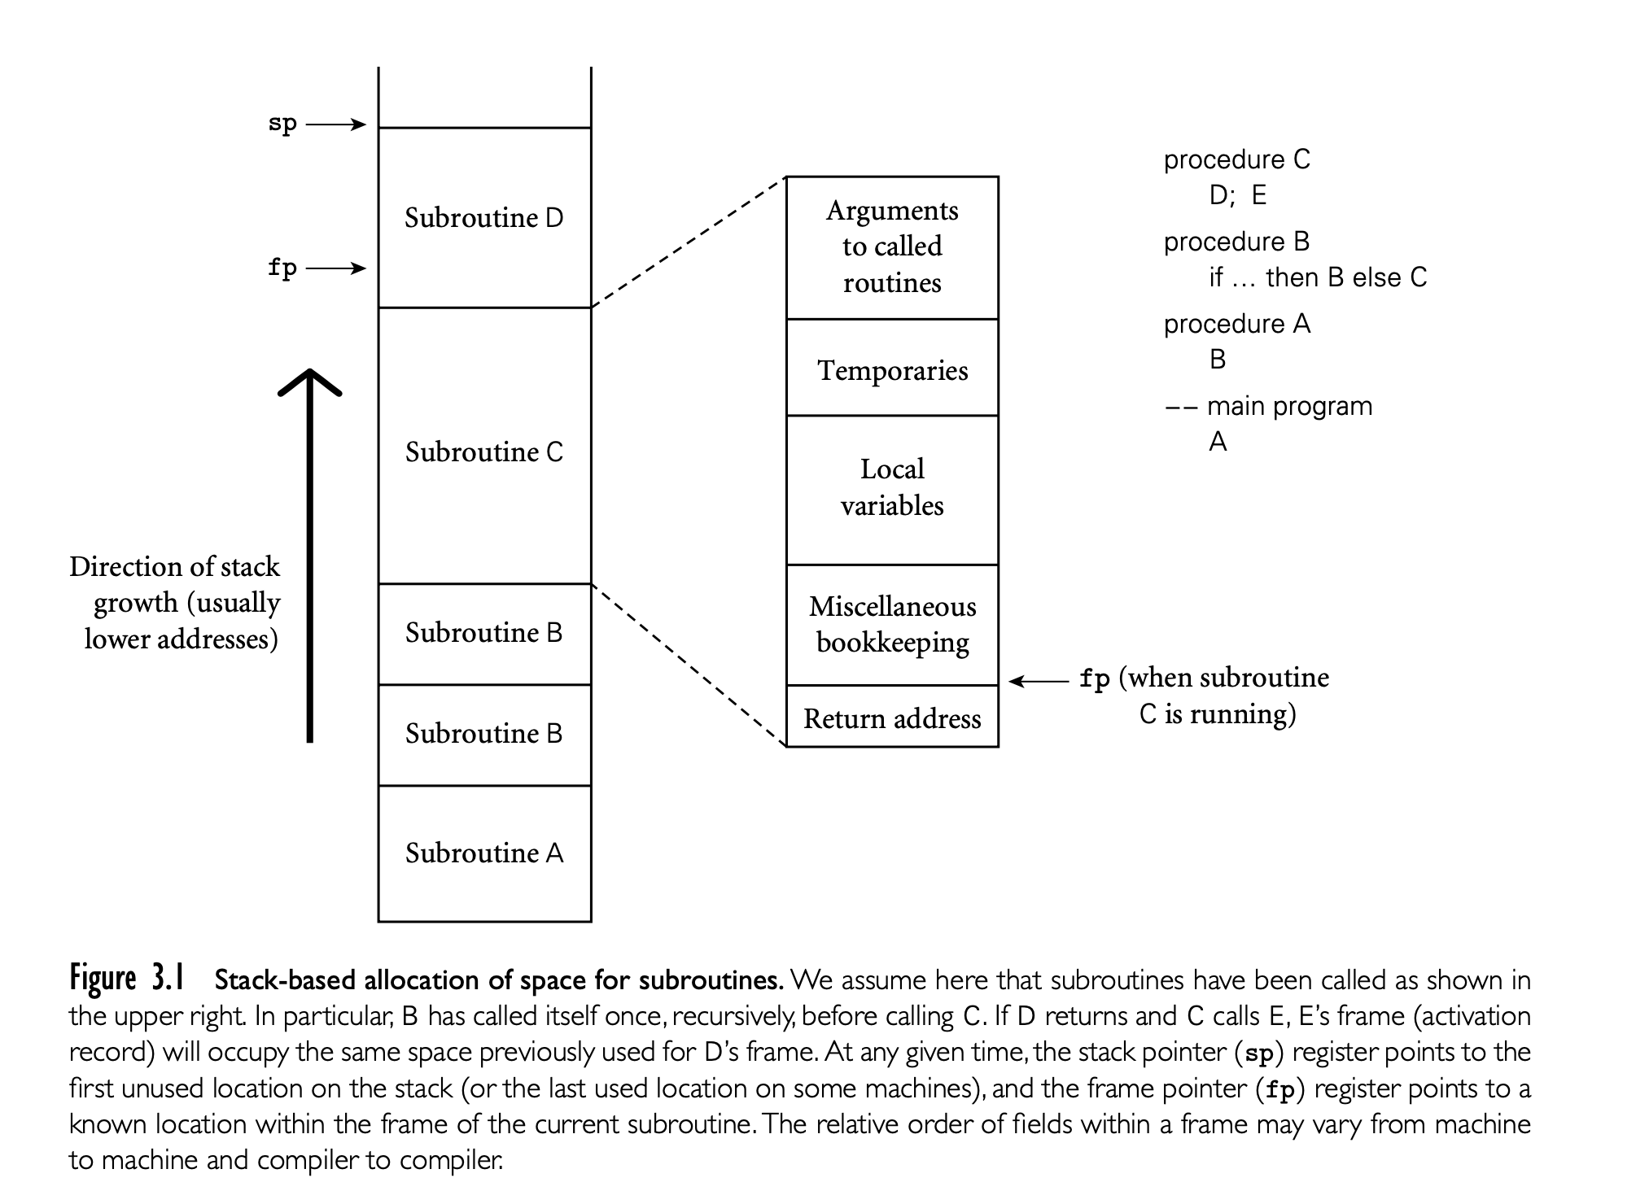

Slide 24
Stack Objects
The stack grows “downward” toward lower addresses in most language implementations
Even in a language without recursion, it can be advantageous to use a stack for local variables, rather than allocating them statically
In most programs the pattern of potential calls among subroutines does not permit all of those subroutines to be active at the same time
As a result, the total space needed for local variables of currently active subroutines is seldom as large as the total space across all subroutines, active or not
A stack may therefore require substantially less memory at run time than would be required for static allocation.

Slide 25
Stack Objects
But if a stack frame contains all the local variables of a function, how do we account for local scopes within a function?
  i.e . how do we, at runtime, differentiate between both x variables?
  By giving each identifier a lexical address!
int main(){
int x = 10;
if(x){
int x = 5;
}
}

Slide 26
Lexical Addresses
Each declared name has a lexical address which is composed of a level number and an offset
  Level number starts at 0 and increments into each nested block
  Offset starts at 0 and increments whenever another name is declared in the specific block
  Allows compiler to differentiate between same names in different scopes
No run-time work is needed to allocate or deallocate space for variables declared in nested blocks
  Their space can be included in the total space for local variables allocated in the stack frame
Notes:
We could use lexical addresses to completely replace variable names
Some scope rules are inherent to the runtime environment, others are contrived and enforced at compile time

Slide 27
Lexical Addresses
//Where the first subscript is the level number and the second //subscript is the offset
int main(){
int x = 10; //x₀₀
int y = 20; //y₀₁
if(x){
int y = 10; //y₁₀
int x = 5; //x₁₁
{
int y = 100; //y₂₀
}
}
}
Notes:
We could use lexical addresses to completely replace variable names

Slide 28
Allocation, Lifetimes, and the Environment
To allow for arbitrary allocation and deallocation the environment must have an area in memory from which locations can be allocated
A heap is a region of storage in which subblocks can be allocated and deallocated at arbitrary times
Heaps are required for the dynamically allocated pieces of linked data structures, and for objects like fully general character strings, lists, and sets, whose size may change as a result of an assignment statement or other update operation
Some languages also have size restrictions on static and stack objects, which also necessitates the need for a heap

Slide 29
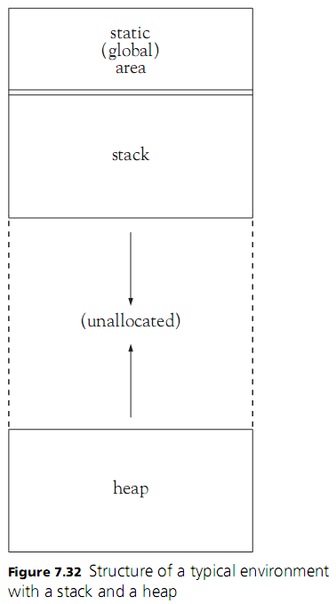
Allocation, Lifetimes, and the Environment

